Slide 1
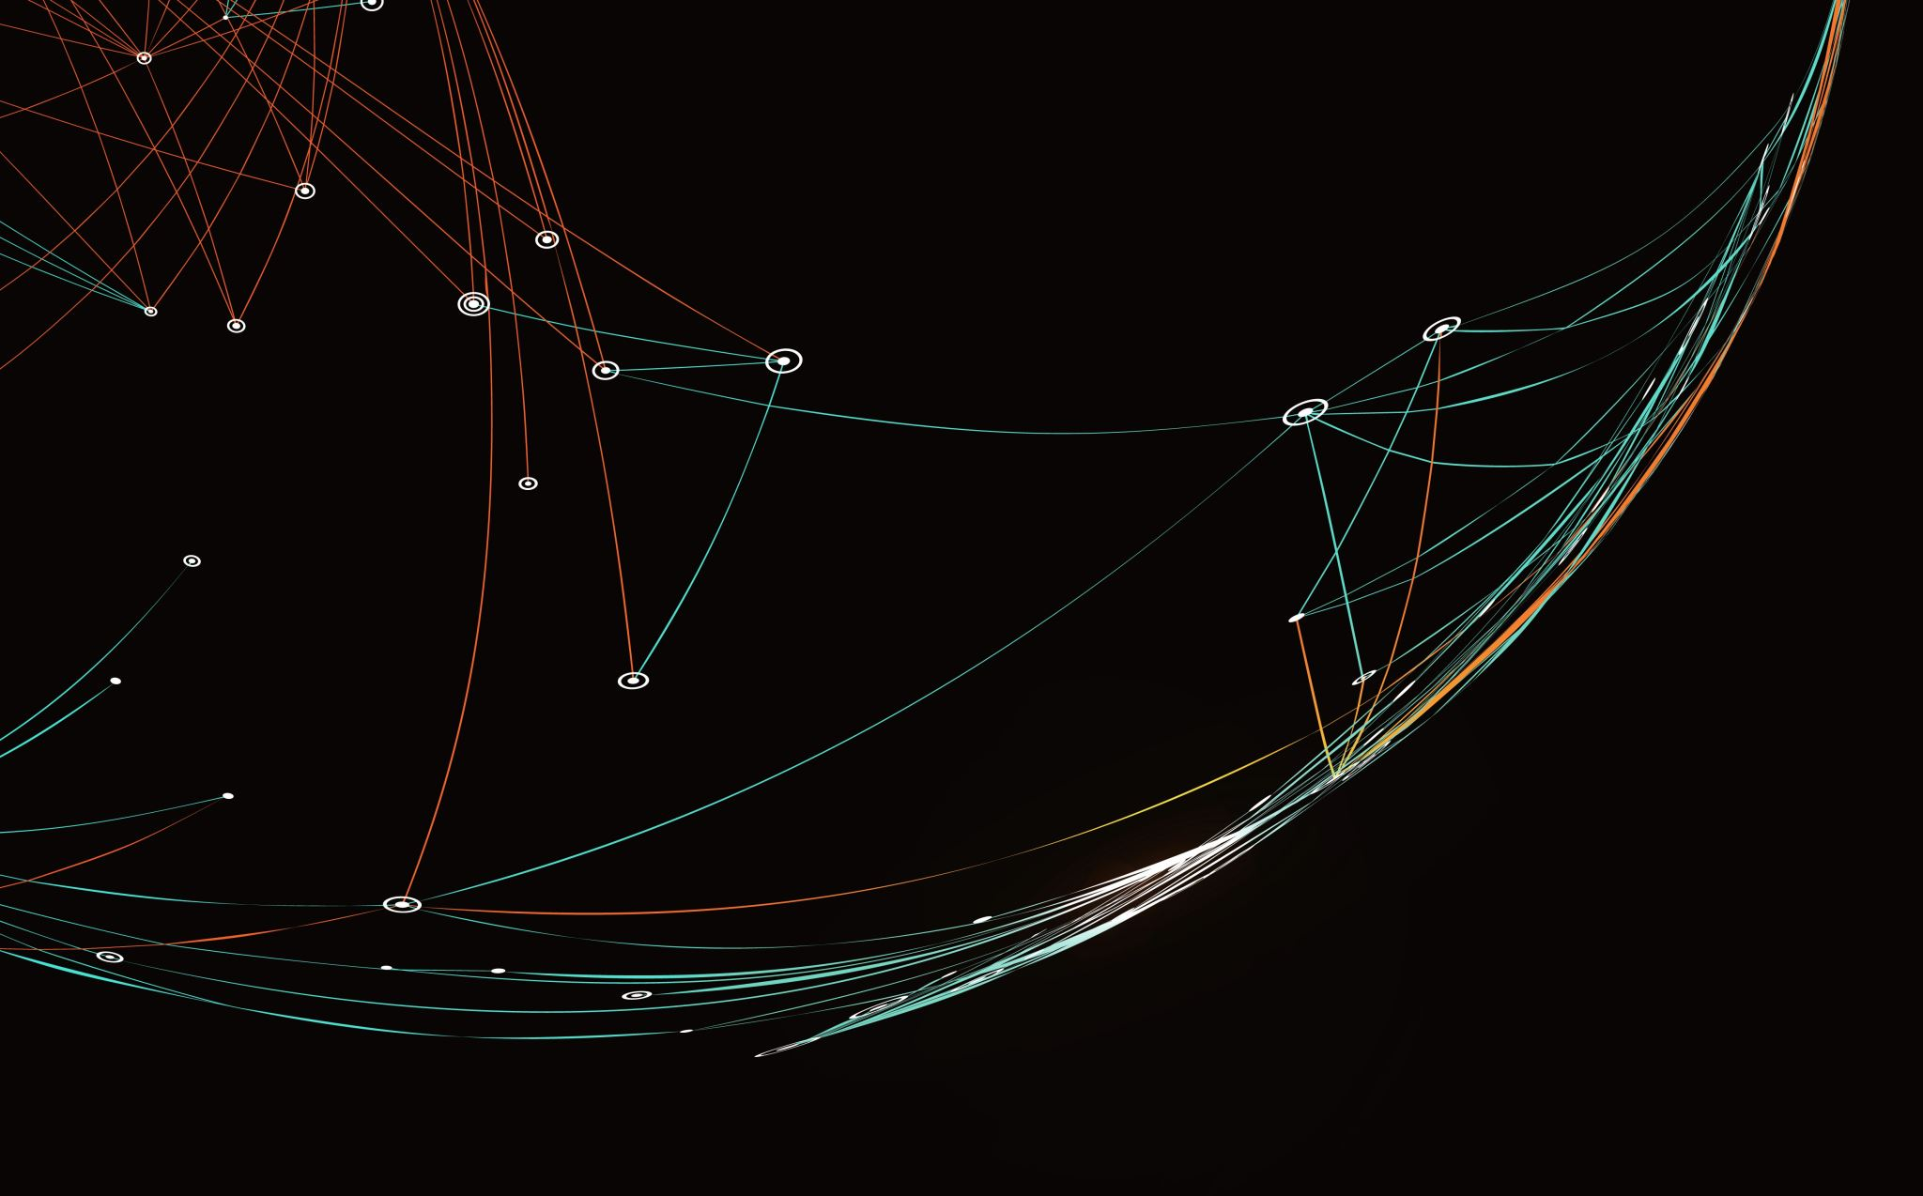
Enhancing Image Colorization Using Conditional Generative Adversarial Network
| Avanith Kanamarlapudi | Rami Huu Nguyen | Lakshmi Pranathi Vutla |

Slide 2
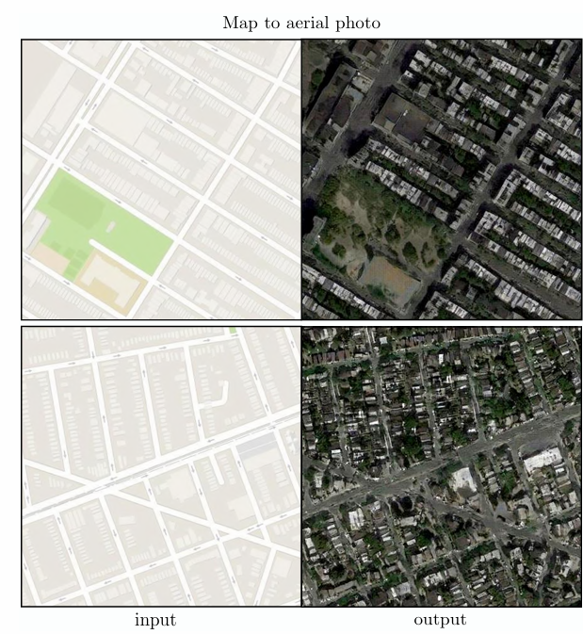
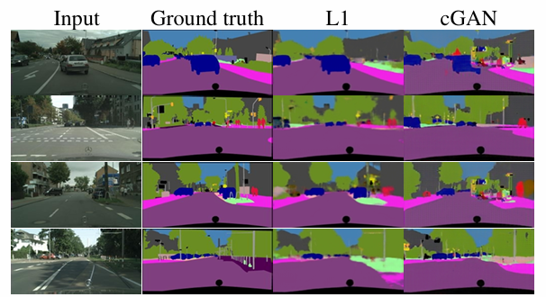
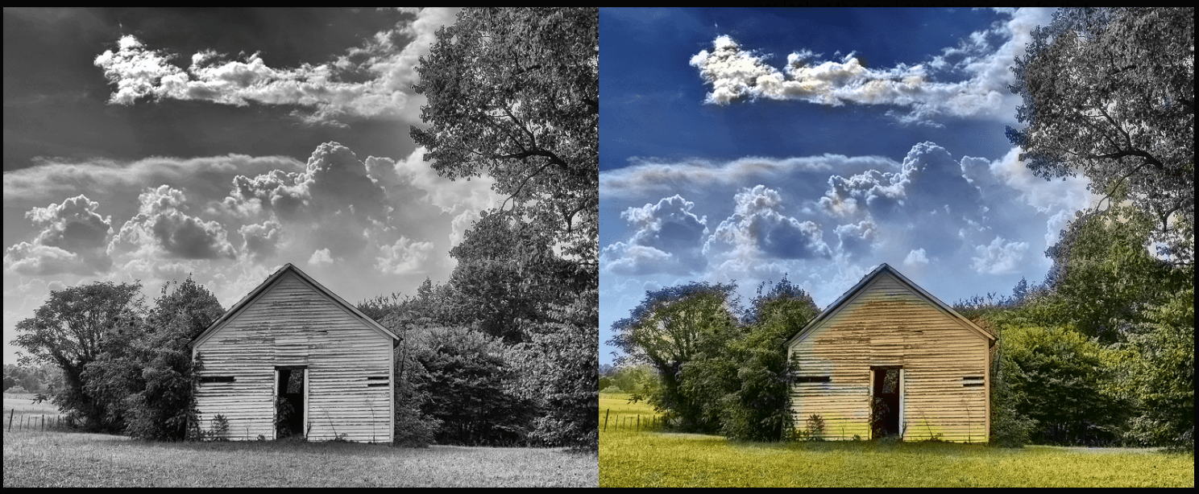
What is Image Colorization?
Process of adding realistic color to grayscale images
Used in: historical restoration, semantic segmentation, edge detection
Supports better machine and human understanding of visual content
Critical in education, media, forensics, and AI explainability

Slide 3
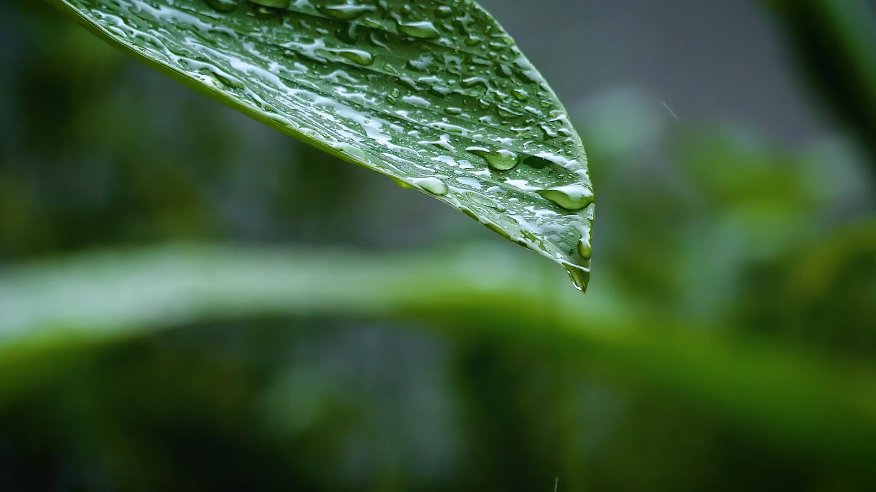
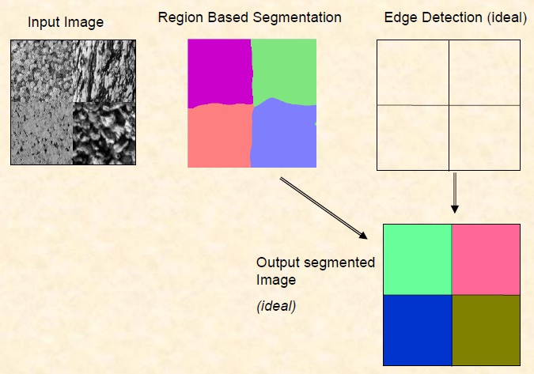
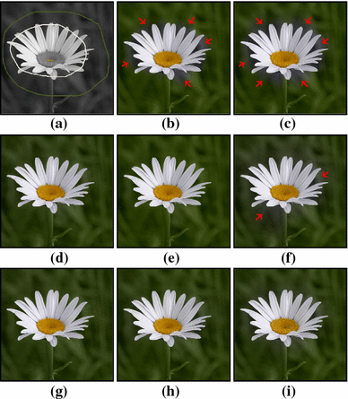
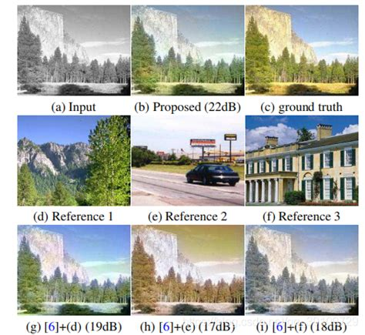
Traditional Methods Were Manual
Color hints (scribbles) required by human artists
Manual selection of similar reference images
Region-based segmentation to guide color placement
Labor-intensive and not scalable for large datasets

Slide 4
Why Colorization is Challenging
A single gray pixel may represent multiple possible colors (e.g., red or blue)
Requires high-level semantic understanding
Color ambiguity makes automated methods non-trivial

Slide 5
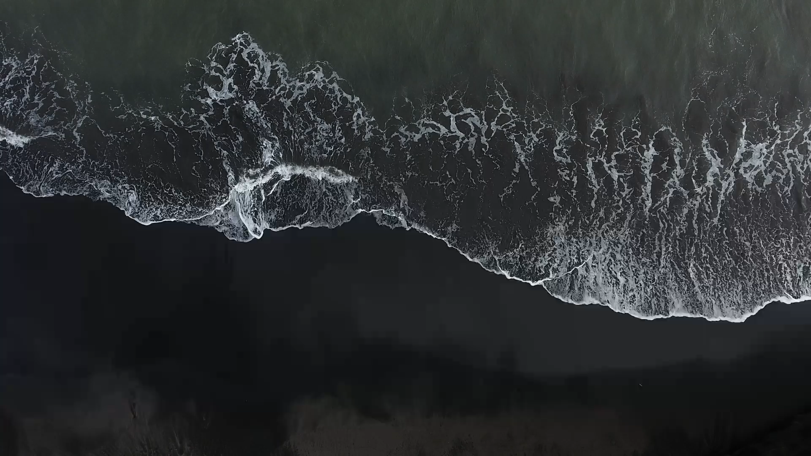
Colorizing grey images into color is not straight forward tasks.
There are some current methods of colorization.

Slide 6
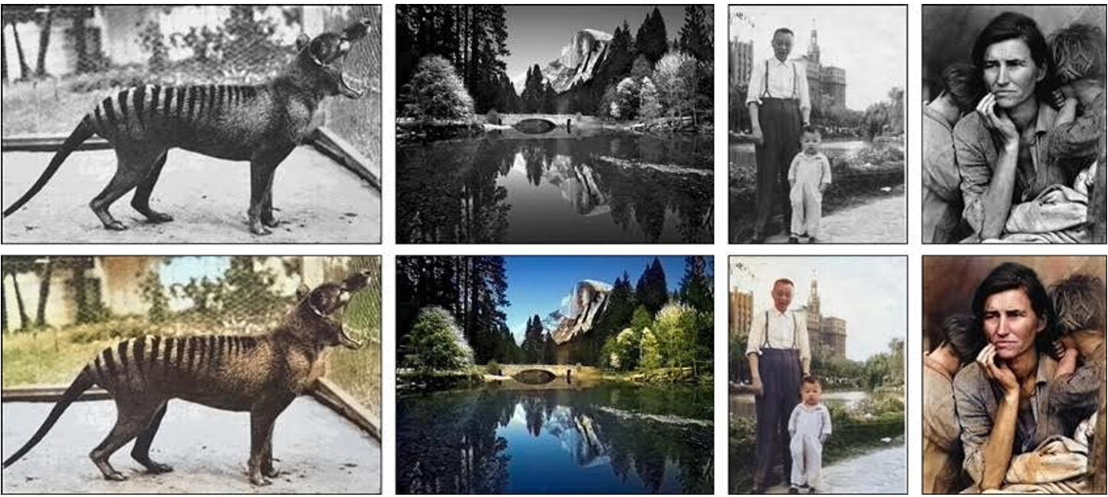
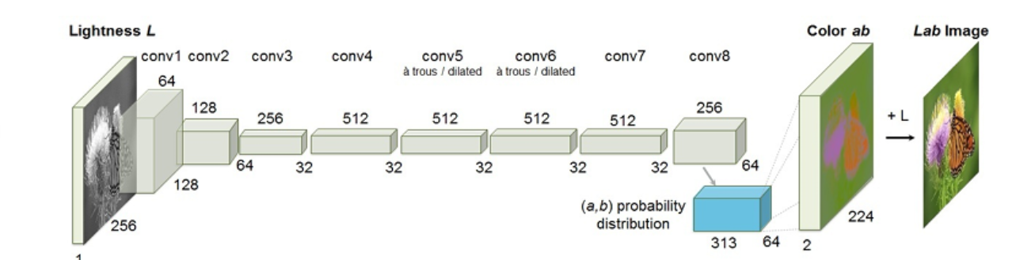
Existing Solution – Zhang et al.
Used CNN to fully automate grayscale → color transformation
Introduced the idea of classification-based colorization
Limitation: Struggled with multimodal color possibilities
Predicted common but less vibrant or diverse colors

Slide 7
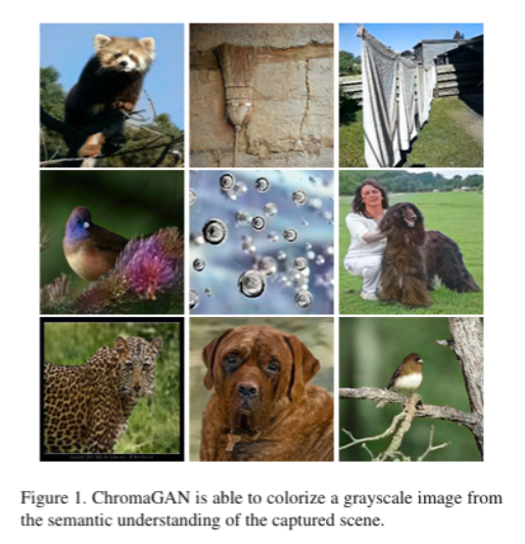
Example of ChromaGAN
ChromaGAN uses dual-branch generator: predicts chrominance + semantic labels
Based on VGG-16 with PatchGAN discriminator
Handles multimodal outputs using semantic guidance
Weakness: Requires deep features and semantic supervision

Slide 8
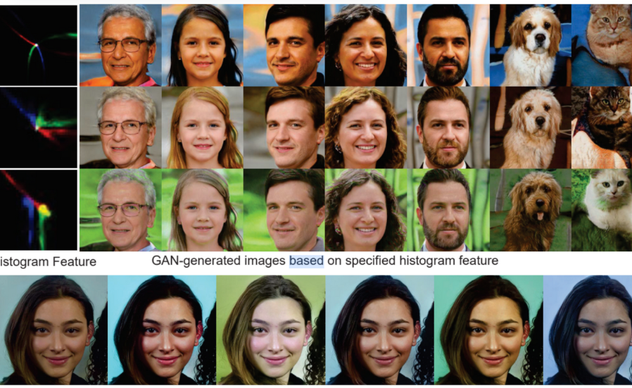
Example of HistoGAN
Uses color histograms to control GAN generated image outputs
Works on both real and generated images
Offers precise artistic control over recoloring
Limitation: may introduce unrealistic or shifted tones on rare classes

Slide 9
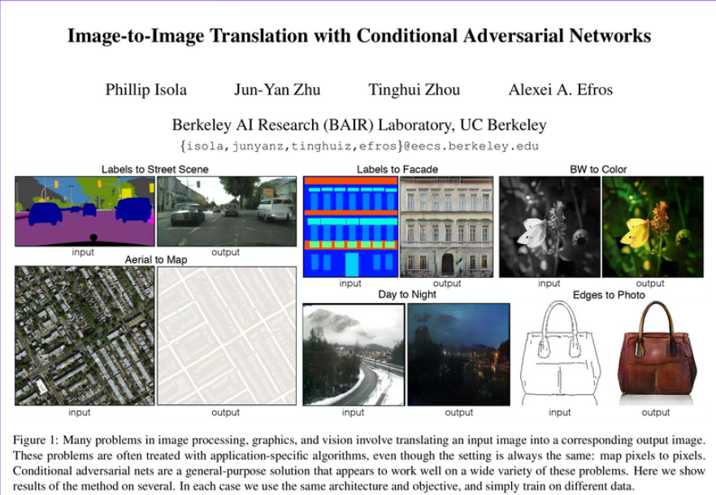
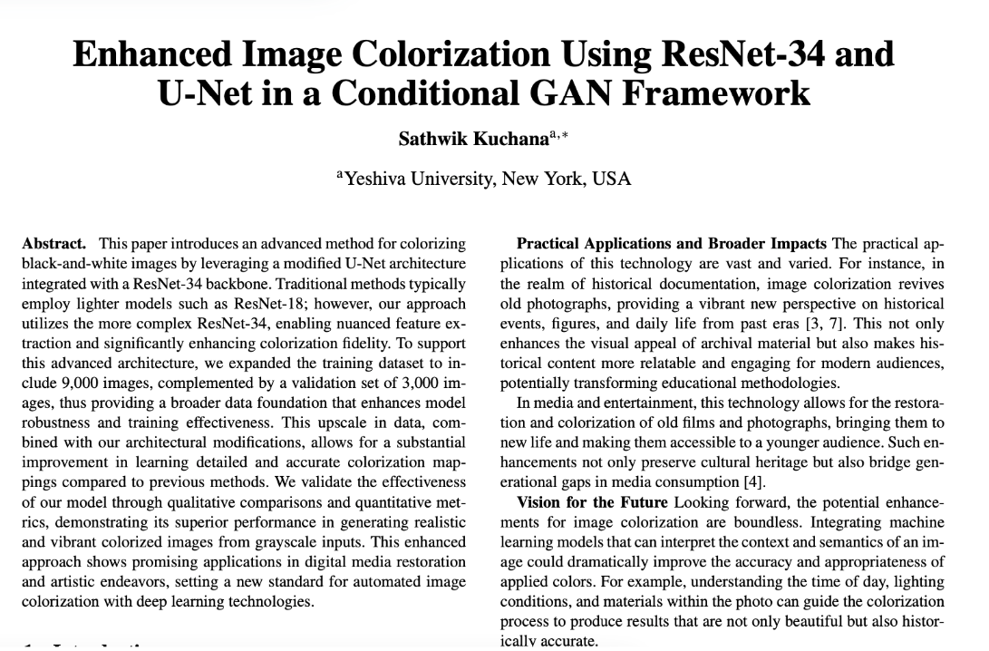
These two related works influenced our project and helped guide our model design.
First paper : Introduced cGan with PatchGAN and L1 , loss , forming the base of our model.
Second one : Used ResNet + U-Net for accurate colorization , we adapted with ResNet18 for efficiency.
Combined influence led us to build a model with realism + structure
These papers informed our loss functions, architecture, and data diversity strategies

Slide 10
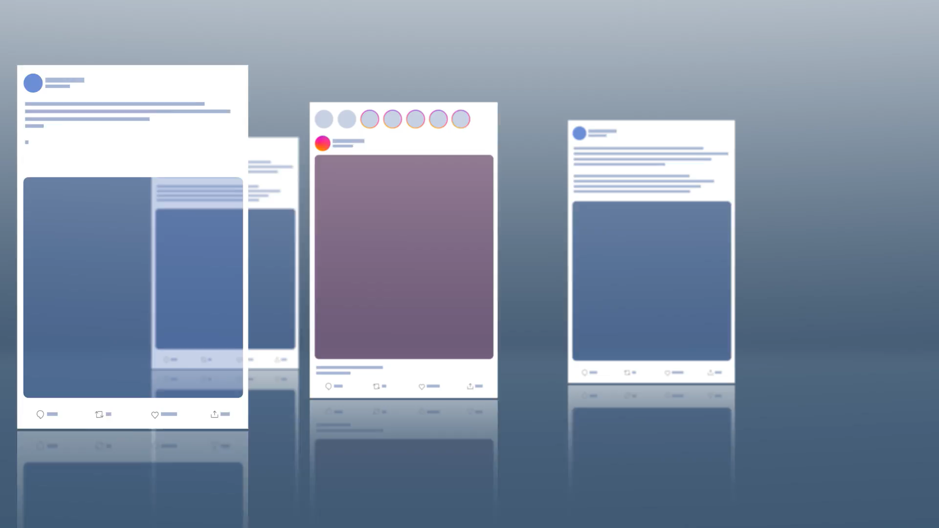
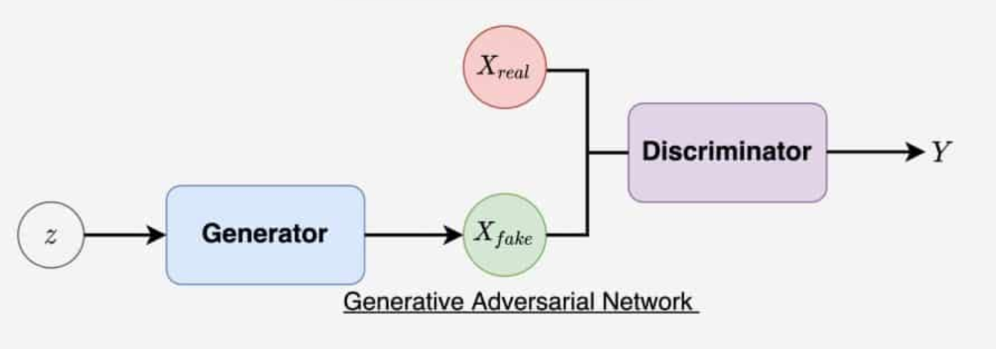
What is a GAN?
GAN = Generator + Discriminator trained in adversarial setup
Generator tries to fool the discriminator
Discriminator learns to distinguish fake from real
Together they improve through back-and-forth training

Slide 11
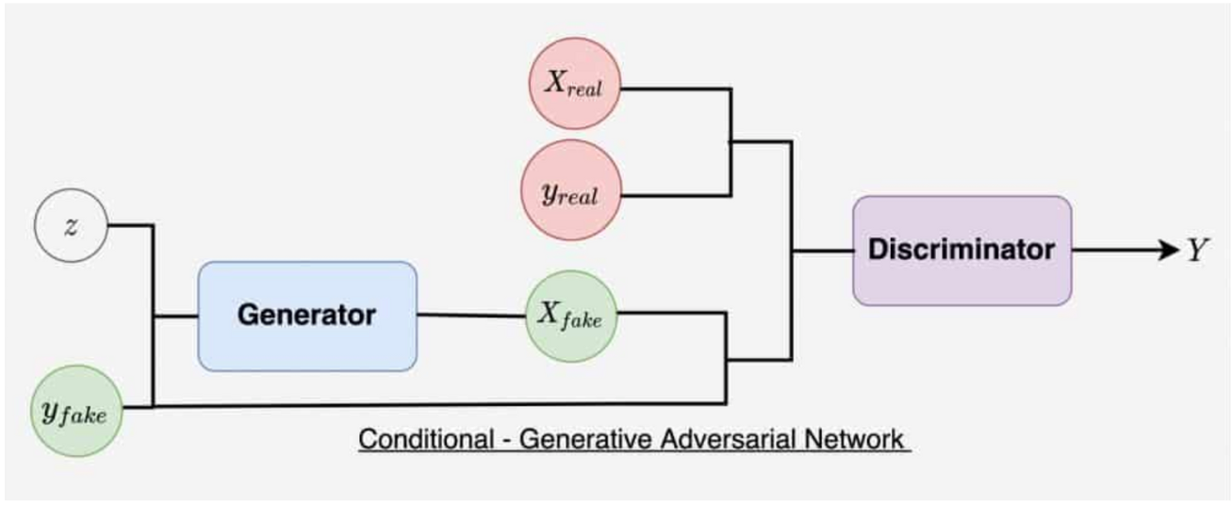
What is Conditional GAN (cGAN)?
CGAN takes grayscale image as input instead of random noise
Generator output is guided by actual input image
Enables targeted, controlled image translation
Crucial for tasks like colorization, segmentation, image editing

Slide 12
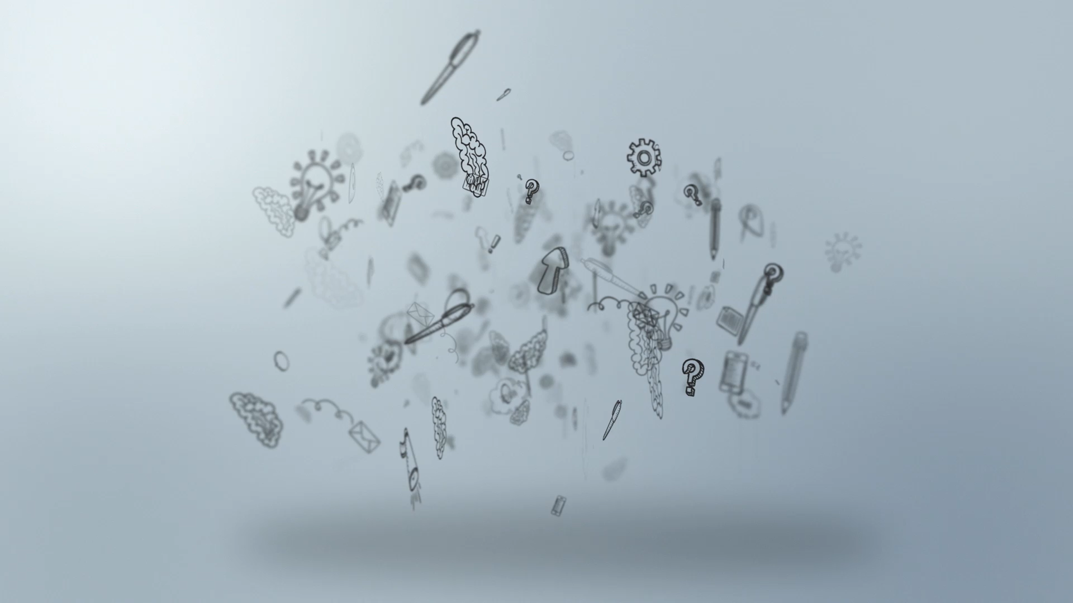
GAN vs. cGAN
Difference between GAN and cGAN
GAN: Generates images from noise cGAN: Generates images based on input conditions (e.g., grayscale image)
cGAN produces results aligned with input structure
Ensuring output is both sharp and accurate

Slide 13
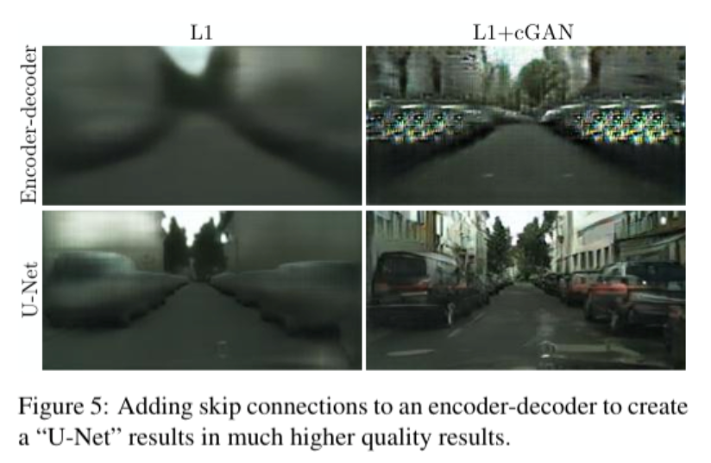
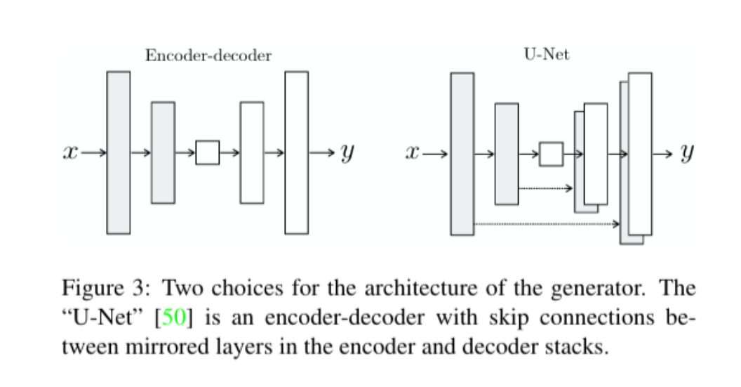
Why We Chose Their Papers
Used λ = 100 to combine L1 + GAN loss
Combined loss gave best results: L1 = structure, GAN = realism
Balanced local details and global realism

Slide 14
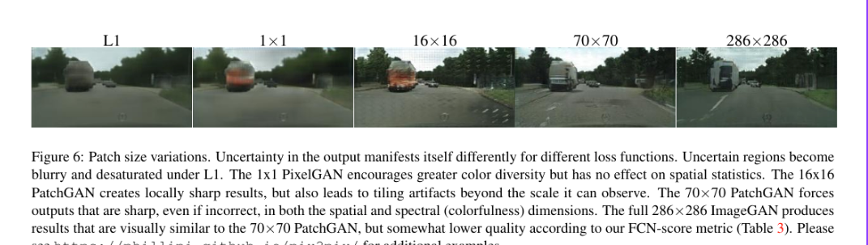
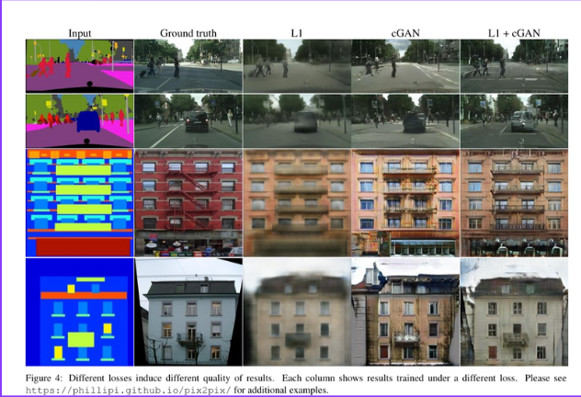
Why We Chose Their Papers
Used 70×70 PatchGAN instead of whole image discriminator
CGAN: When they experimented with both losses and set λ = 100, we get the best results—images that are both sharp and accurate.

Slide 15
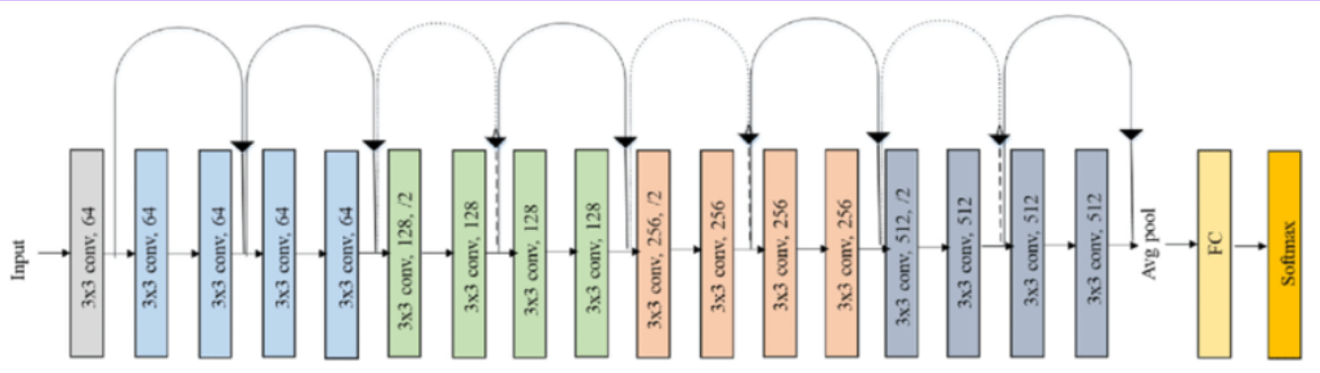
Model Selection: ResNet18 vs ResNet34
[2] Paper used ResNet34 but it’s computationally heavy
01
We used ResNet18: faster, efficient, similar results
02
Ideal for real-time applications and lower-end devices
03
Final Generator = ResNet18 + Dynamic UNet
04

Slide 16
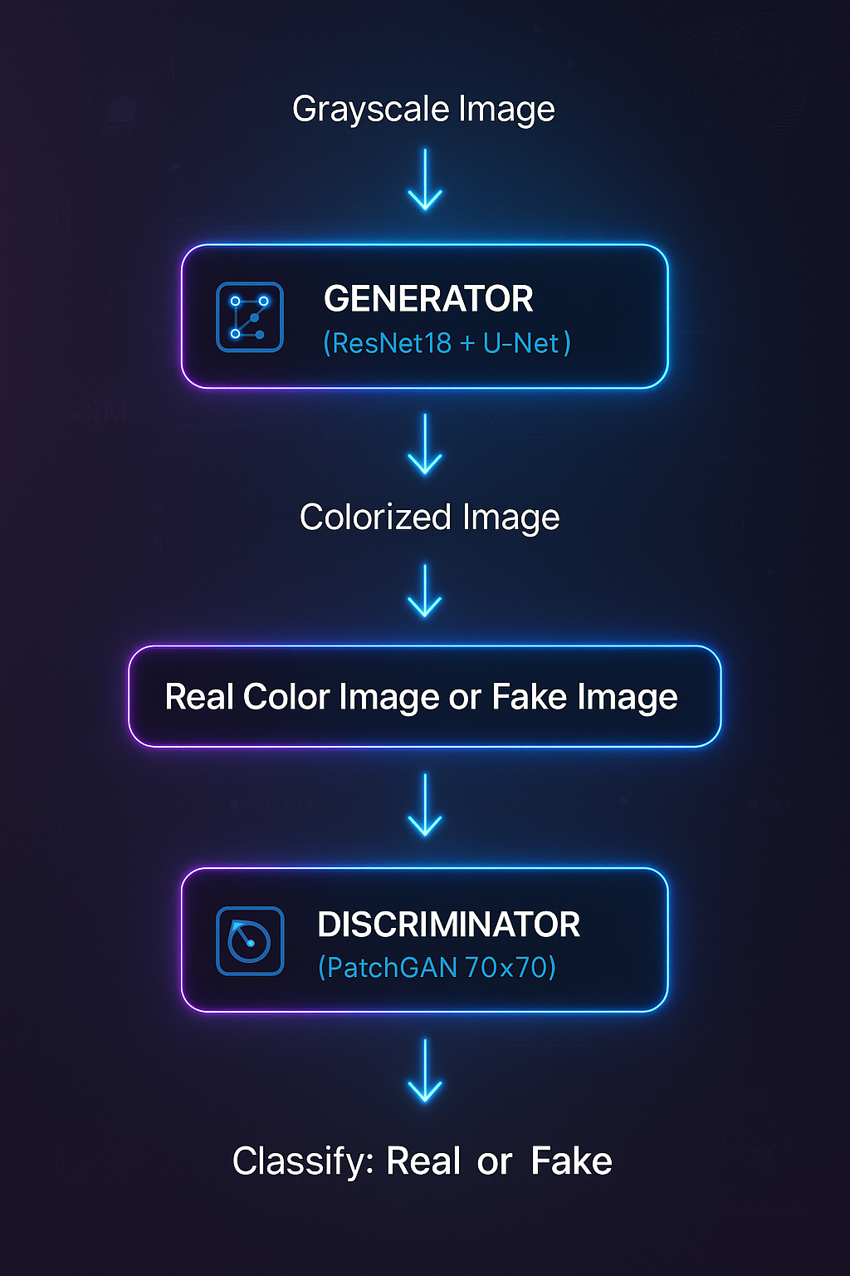
Our Model Architecture

Slide 17
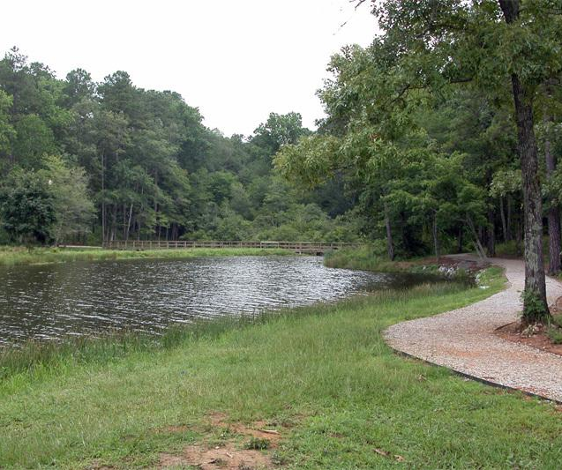
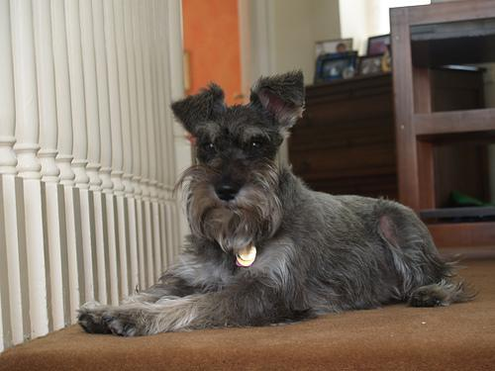
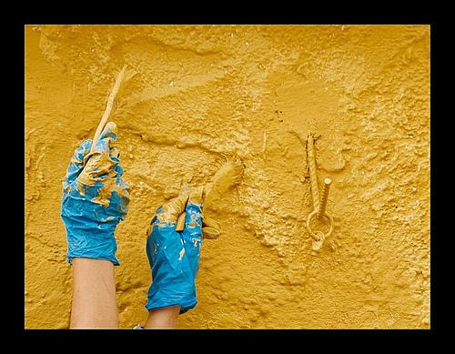
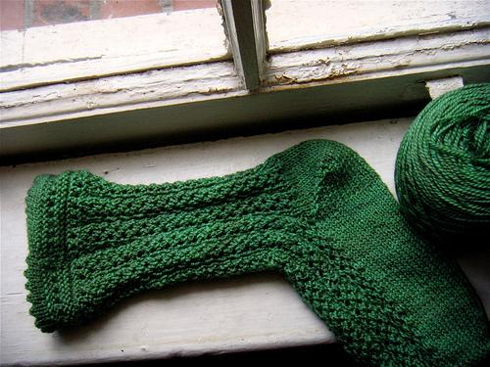
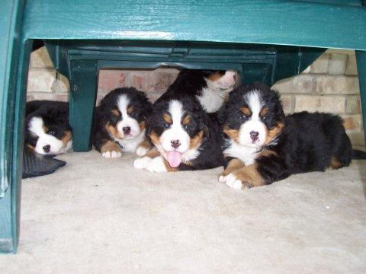
Dataset Samples
Used a subset of ImageNet-6K dataset
Real-world examples: dogs, birds, helmets, landscapes

Slide 18

Dataset Preparation
Randomly extracted:
5000 images for training
1000 images for validation
100 images for testing
Used validation images only after training ResNet18.
Applied data augmentation by randomly rotating images between 0° and 180°.
Added augmented images to the training set, doubling it to 10,000 training images total.

Slide 19
Loss Functions Used
L1 Loss: Ensures structural similarity to ground truth
cGAN Loss: Enhances visual realism by fooling the discriminator Final Loss: Loss_G = GAN_Loss + λ * L1_Loss (λ = 100 for best results)

Slide 20
Evaluation Metric: PSNR
PSNR = Peak Signal-to-Noise Ratio
Measures similarity to ground truth image
Higher PSNR → Better reconstruction quality
Final model achieved PSNR = 22 on test set

Slide 21
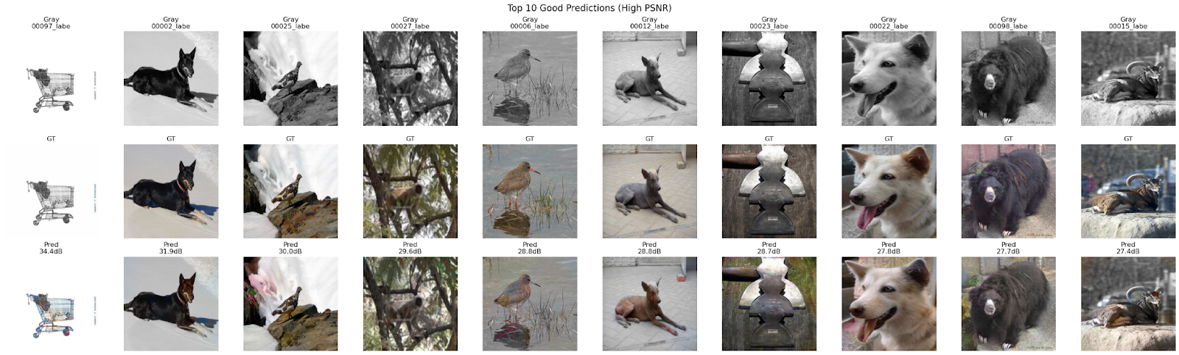
Top 10 Best Results (Why These Images Performed Well)
Simple textures (snow, fur, feathers)
Training dataset included similar examples
Clear object-background separation aided generator

Slide 22
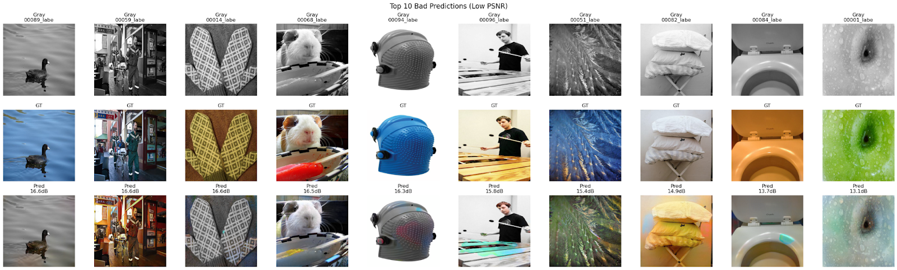
Top 10 Worst Results Low PSNR, noticeable artifacts Examples: duck on water, plastic helmets Complex textures or reflections
Why These Images Failed
Lack of semantic understanding
Unfamiliar object classes in training
Background confusion from reflection or lighting
Cannot recognize the vivid color

Slide 23
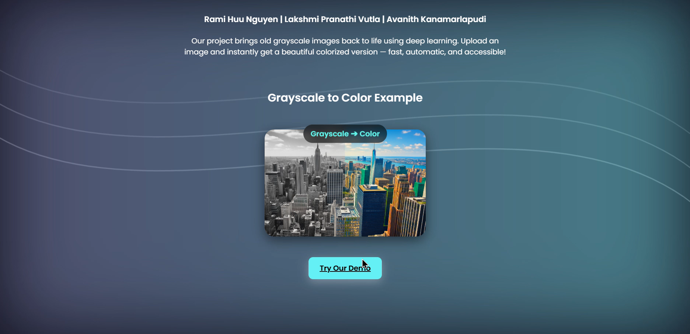
Our Web Demo

Slide 24

Limitations
Confusion with Complex Scenes Struggled when grayscale images had shiny textures or unclear objects (e.g., Helmets, water reflections).
LACK OF OBJECT UNDERSTANDING The model couldn't always identify what the object was—leading to inaccurate color predictions.
Limited Data Variety Underperformed on rare or unusual textures not well represented in the training data.

Slide 25
Future Work
Add
Add semantic segmentation to guide color prediction
Use
Use attention mechanisms to focus on object regions
Replace
Replace PSNR with human feedback or perceptual loss

Slide 26
Conclusion
Conditional GAN + ResNet18 + UNet = balance of speed + realism
L1 + GAN loss = structural + visual quality
Still room to improve rare object colorization and context awareness
Strong foundation for practical applications

Slide 27
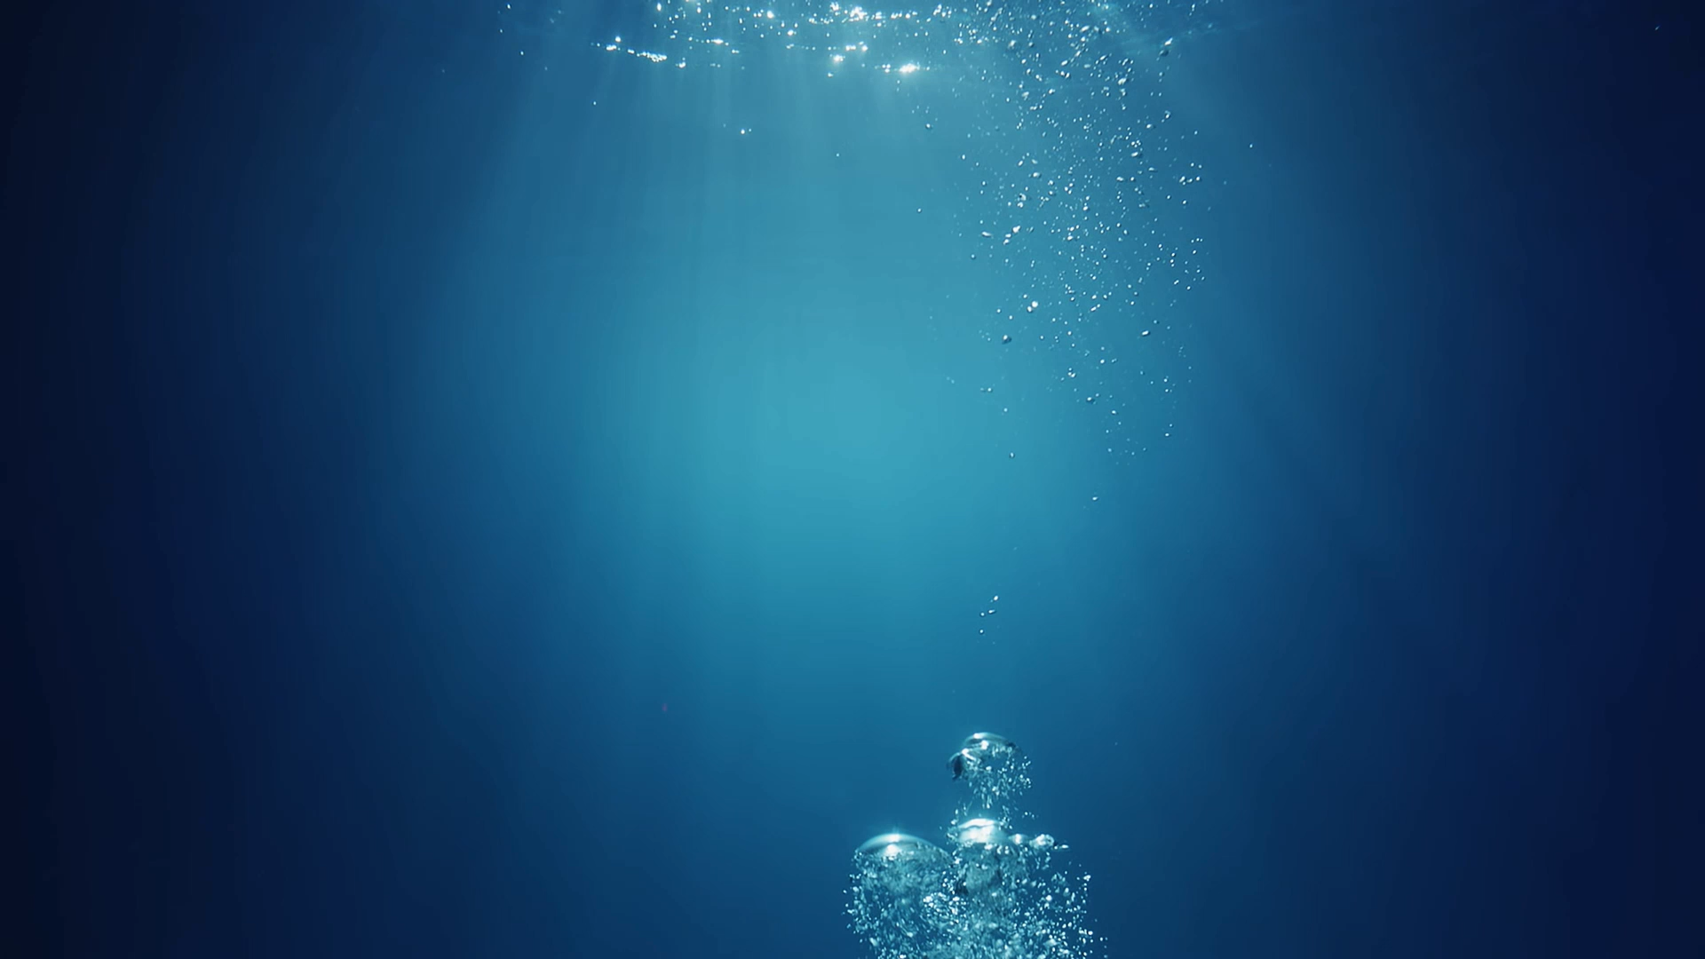






Enhancing Image Colorization Using Conditional Generative Adversarial Network
UMass Boston, Department of Computer Science
Special thanks to Professor Tales de Oliveira Imbiriba
Gratitude to Fast AI, PyTorch, Hugging Face, and ImageNet
Thank You !
Rami Huu Nguyen Avanith Kanamarlapudi Lakshmi Pranathi Vutla
View our code and result
through barcode GITHUB
Scan QR Code to visit our LinkedIn Profile
#Computervision
#Spring2025

